Slide 1
Automating Invoice Data Extraction Using Python
By Boris Kim

Slide 2
Introduction – Why This Project?
Problem:
Manual invoice entry is slow, repetitive, and error-prone.
High workload for accounting teams, especially in SAP or similar systems.
Objective:
Automate extraction of key invoice data (Number, Date, Amount) from PDFs.
Learn Python through solving a real-world problem.

Slide 3
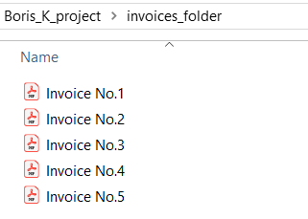
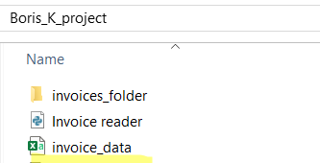
Tools & Technologies
Libraries Used:
PyMuPDF (fitz): To extract text from PDFs.
re (Regex): To locate invoice fields in raw text.
pandas: To format and export data as a CSV.
Setup:
Place all PDFs in a folder.
Run the Python script.
Get structured data in a CSV instantly.

Slide 4
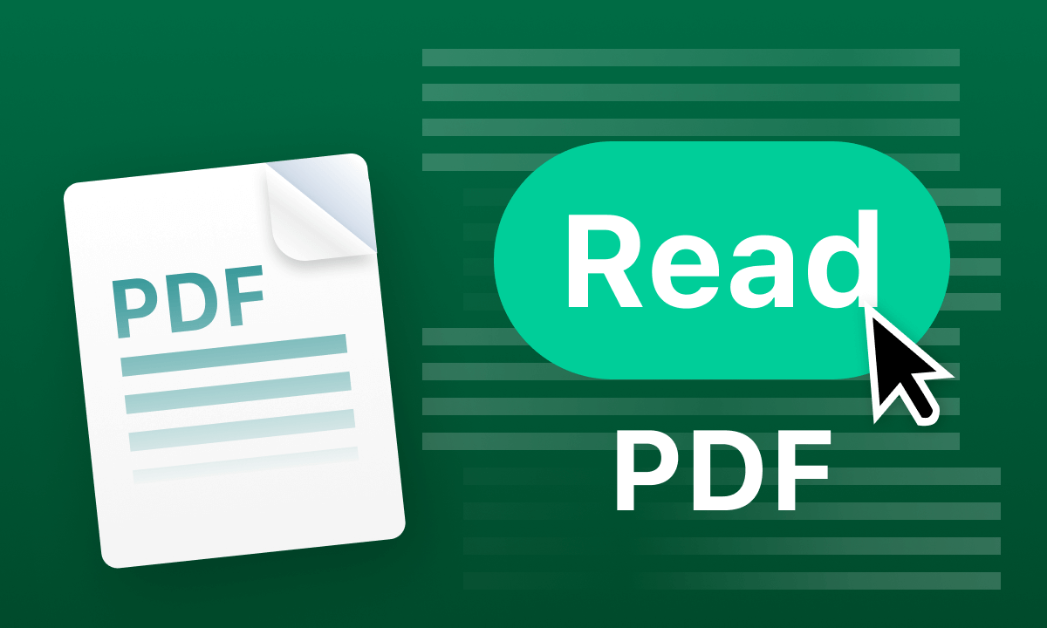
How It Works
Read PDFs from the specified folder.
Extract Data using regex:
Invoice number
Invoice date
Invoiced amount
Store Data in a DataFrame.
Export to CSV: invoice_data.csv
Open the CSV automatically after processing.

Slide 5
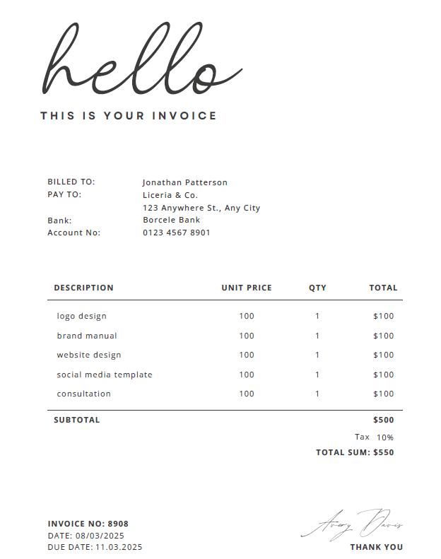
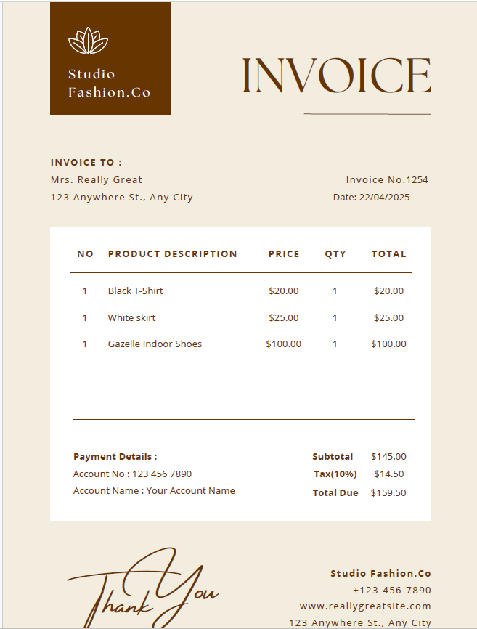
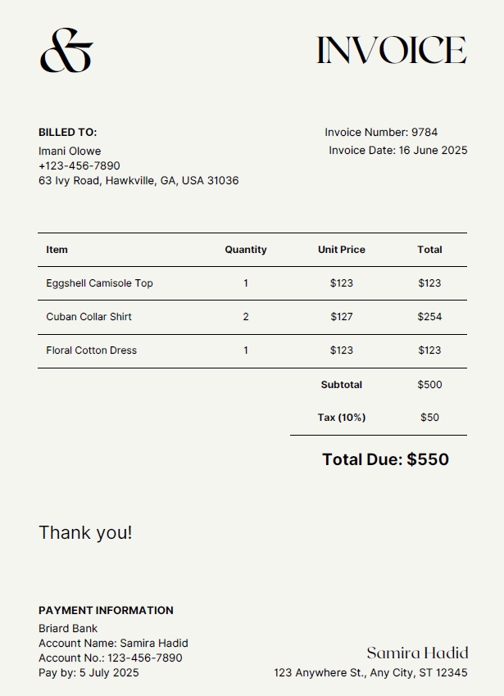
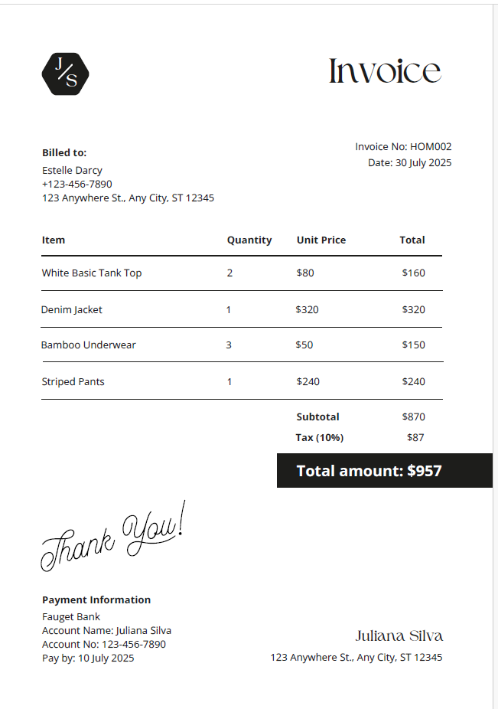
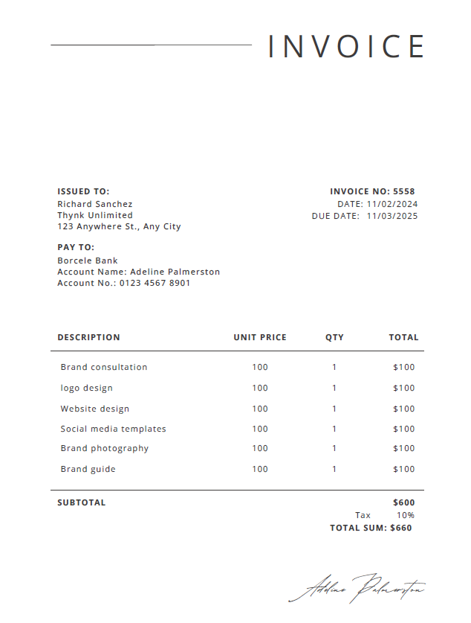
Invoices

Slide 6
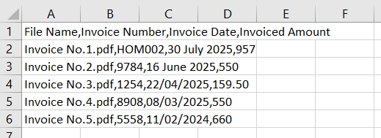
Example Output

Slide 7
Conclusion
Impact: Saves time, reduces manual error, and improves efficiency.
Outcome: A simple automation tool for invoice processing.
Personal Growth: Stronger Python foundation and real-world problem-solving.

